Slide 1
NTRU
Fairly Old at this point

Slide 2
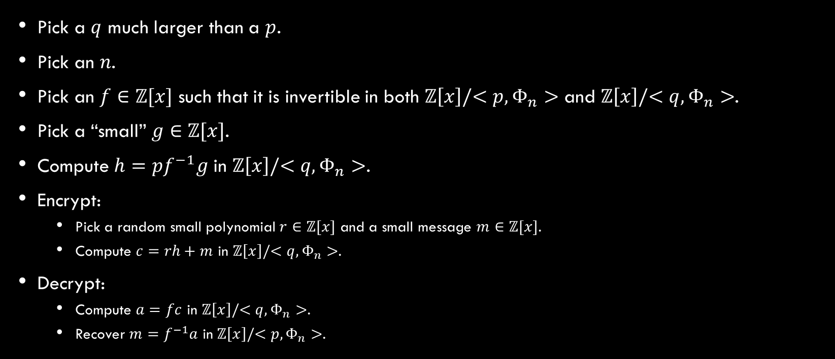
What is NTRU?
Pick a $q$ much larger than a $p$.
Pick an $n$.
Pick an $f∈ℤ[x]$ such that it is invertible in both $ℤ\left[x\right]/<p,Φ_{n}>$ and $ℤ\left[x\right]/<q,Φ_{n}>$.
Pick a “small” $g∈ℤ[x]$.
Compute $h=pf^{−1}g$ in $ℤ\left[x\right]/<q,Φ_{n}>$.
Encrypt:
  Pick a random small polynomial $r∈ℤ[x]$ and a small message $m∈ℤ[x]$.
  Compute $c=rh+m$ in $ℤ\left[x\right]/<q,Φ_{n}>$.
Decrypt:
  Compute $a=fc$ in $ℤ\left[x\right]/<q,Φ_{n}>$.
  Recover $m=f^{−1}a$ in $ℤ\left[x\right]/<p,Φ_{n}>$.

Slide 3
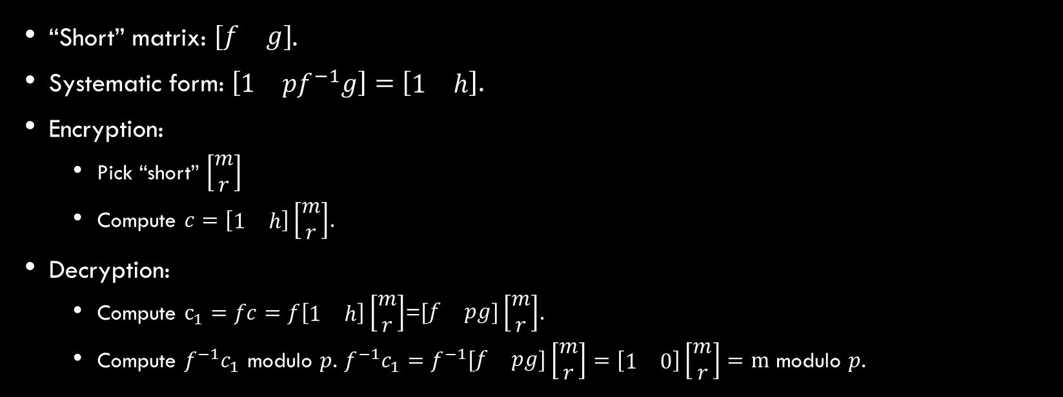
QUOTIENT LWE
“Short” matrix: $\left[\begin{matrix}f & g\end{matrix}\right]$.
Systematic form: $\left[\begin{matrix}1 & {pf}^{−1}g\end{matrix}\right]=\left[\begin{matrix}1 & h\end{matrix}\right]$.
Encryption:
  Pick “short” $\left[\begin{matrix}m \\ r\end{matrix}\right]$
  Compute $c=\left[\begin{matrix}1 & h\end{matrix}\right]\left[\begin{matrix}m \\ r\end{matrix}\right]$.
Decryption:
  Compute $c_{1}=fc=f\left[\begin{matrix}1 & h\end{matrix}\right]\left[\begin{matrix}m \\ r\end{matrix}\right]$=$\left[\begin{matrix}f & pg\end{matrix}\right]\left[\begin{matrix}m \\ r\end{matrix}\right]$.
  Compute $f^{−1}c_{1}$ modulo $p$. $f^{−1}c_{1}=f^{−1}\left[\begin{matrix}f & pg\end{matrix}\right]\left[\begin{matrix}m \\ r\end{matrix}\right]=\left[\begin{matrix}1 & 0\end{matrix}\right]\left[\begin{matrix}m \\ r\end{matrix}\right]=m$ modulo $p$.

Slide 4
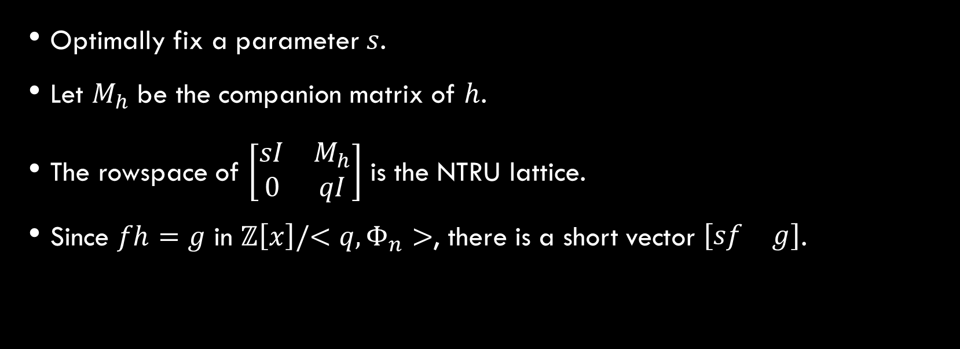
Lattice Attack
Optimally fix a parameter $s$.
Let $M_{h}$ be the companion matrix of $h$.
The rowspace of $\left[\begin{matrix}sI & M_{h} \\ 0 & qI\end{matrix}\right]$ is the NTRU lattice.
Since $fh=g$ in $ℤ\left[x\right]/<q,Φ_{n}>$, there is a short vector $\left[\begin{matrix}sf & g\end{matrix}\right]$.

Slide 5
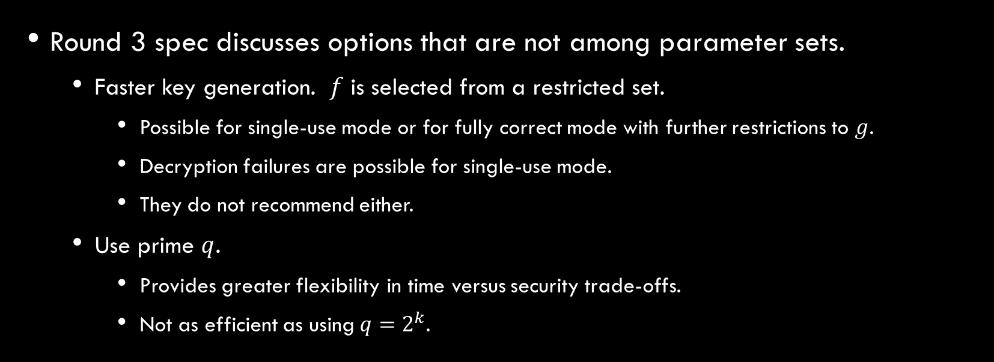
Options
Round 3 spec discusses options that are not among parameter sets.
  Faster key generation. $f$ is selected from a restricted set.
    Possible for single-use mode or for fully correct mode with further restrictions to $g$.
    Decryption failures are possible for single-use mode.
    They do not recommend either.
  Use prime $q$.
    Provides greater flexibility in time versus security trade-offs.
    Not as efficient as using $q=2^{k}$.

